Slide 1
Reach out (Referral)
Design Sprint
Product Manager: Chikamso Nwani
© 2019 Udacity. All rights reserved.

Slide 2
Set the stage
Set the stage for the Design Sprint by framing the problem
© 2019 Udacity. All rights reserved.
Notes:
[ALL PARTICIPATION]

Slide 3
Initial PRD
Background
In the past, college graduates would search and find jobs by going through volumes of fliers, posters, newspapers and other forms of media. This process was filled with a lot of faults; since there was no aggregated platform for jobs, candidates would waste time trying to filter jobs they were likely to get and in some cases not even finding the jobs they wanted. Also, since there was limited budgets to promote jobs, recruiters would not always present the whole picture about the jobs being offered and thus fail to reach relevant candidates. With the fast pace of technological advancement, businesses are beginning to offer curated jobs matching recruiters with candidates.
Problem
With 6 million graduates coming out of college annually, the total addressable market for recruitment today is a $2.2 Billion prize. We are not alone at looking at this. Other competitors both directly and indirectly are offering products and services for graduates to search and find jobs. In less than a month after signing up with Indeed, about 40% of candidates say they get their dream jobs or are about to. We have the single largest online professional network, we can expand our job offerings to match talent to jobs at scale.
Goals
Create an app that recommends relevant jobs to candidates
Get a 4.5 rating on all app stores
Obtain a “hired through LinkedIn” score of 20%

Slide 4
Features
Our hiring solutions are transforming the talent acquisition market by providing unique access not only to active job seekers but also to passive candidates who are not actively looking to change jobs.

Slide 5
Understand
Create a shared understanding of the space, problem, and goals
© 2019 Udacity. All rights reserved.
Notes:
[ALL PARTICIPATION]

Slide 6
How Might We
Use these digital stickies to capture your ideas. Feel free to rearrange. Colorize. Etc
How might we make job descriptions relevant?
How might we collect better job preferences data?
How might we offer even more jobs to candidates?
How might we help candidates find entry level positions?
How might we bring jobs closer to candidates?
How might we aid employees refer relevant jobs to candidates?
How might we recreate offline career fairs for candidates?
How might we provide jobs to candidates transitioning to new roles?
How might we help candidates make better job choices?
How might we help recruiters deliver better job posts?

Slide 7
How Might We
LinkedIn is trying to expand its job market offerings by creating an app that will recommend the best jobs to recent college graduates based on their skills and preferences.
LinkedIn project

Slide 8
Best Job Seeker Experience
How might we make online career fairs for candidates?
How might we help grads assess job fit?
How might we bring jobs closer to candidates?
How might we help candidates make better job choices?
How might we help colleges grads learn what jobs are really like?
How might we assess jobs for candidates transitioning to new roles?
How might we assess a user's job preferences?
Understand Interests & Preferences
Job Feedback and Insights

Slide 9
Great Employee/Employer Matching
How might we collect better job preferences data?
How might we make job descriptions relevant?
How might we create accurate matches?
How might we create an accurate and reliable recommendation engine?
How might we match skills with employer needs?
How might we find job openings for college grads?
How might we get accurate and timely job market information?
How might we evaluate employer post effectiveness?
Matching
How might we help candidates find entry level positions?
How might we request information from companies?
How might we assess user profile quality?
How might we aid employees refer relevant jobs to candidates?
Identify Open Roles
High Quality Job Posts

Slide 10
Other
How might we help recruiters deliver better job posts?
How might we offer even more jobs to candidates?
How might we partner with college career centers?
How might we develop partnership with schools?

Slide 11
Sprint Focus
Focus | Great Employee/Employer Matching
Slide # | Slide 10
I selected this theme because | [Remove help text before you submit] Explain why you chose that theme The idea behind this is that candidates already know what they want but due to the volume of available jobs that are now aggregated, it becomes much harder in matching them to companies and positions with the right fit. This now makes application process time consuming and stressful.

Slide 12
Define
With an understanding of the problem space, create focus and align on specific outcomes for the Design Sprint
Notes:
[ALL PARTICIPATION]

Slide 13
Reach Out
By LinkedIn
The LinkedIn Reach Out feature was designed to help candidates apply to jobs and receive feedback by leveraging their network. I have particularly found the job application process to be tedious and frustrating. Companies release openings but after applying there’s no feedback or response from their hiring team. So most times, i just apply randomly to any position hoping for the best.
Other applications like Indeed and Monster are quite good but they are limiting in the sense that I only choose jobs I think I am a fit for but there’s little to no feedback from the hiring team. As i just finished from college, this new feature is the kind of help that is needed with my job search. With my LinkedIn profile, I get to view people in my network who have open positions through a jobs board on their profiles and interestingly, i also get to ask for their referrals.
The product also allows me save jobs and gives me a reminder so i don’t miss out due to deadlines. This saves me a whole lot of mental and physical stress, because it brings me closer to the door and get an actual recruiter to see my application and receive authentic, genuine responses.

Slide 14
Success Metrics
Set at least two user-centered goals
Identify changes in user behavior will signal success in reaching the goal
Create a metric to measure each signal
 | Goals | Signals | Metrics
Happiness | Efficient matching Users are happy with the matching system and getting jobs | Surveys App store ratings | Number of 5 star reviews Match to job ratio
Engagement | Users using reminders Users are applying through profiles Users discover relevant new jobs that they wouldn’t have known about before | Added more profiles to the one generated from profile | Average time spent per application
Adoption | Share with friends Nominate friends for similar roles | Refer a friend Social media publicity | Referral sign up rates Referral open/view rates
Retention | Job applications using new profiles | Opt for reminders Push notifications | % of users that opt for reminders Open rates
Task Success | Filling of relevant info like academic info, job experience, skills, job requirements etc. Adding a job to profile Saving a job to apply later | Students complete all fields Students click recommended jobs button | Profile creation completion rates

Slide 15
Sketch
Generate tons of ideas, then narrow them down to two in depth solution sketches
Notes:
[ALL PARTICIPATION]

Slide 16
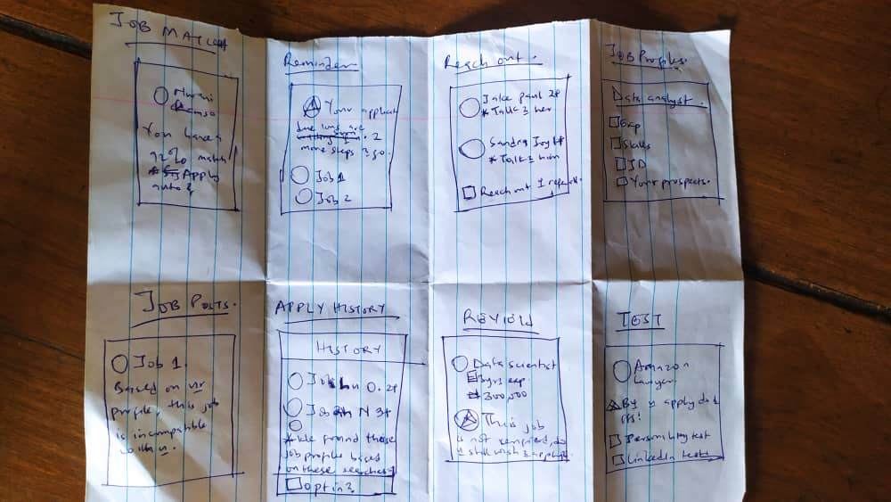
8 Sketches

Slide 17
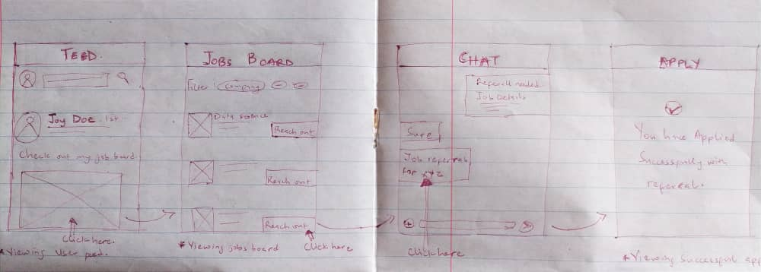
Solution Sketch 1- Reach out (Referral)

Slide 18
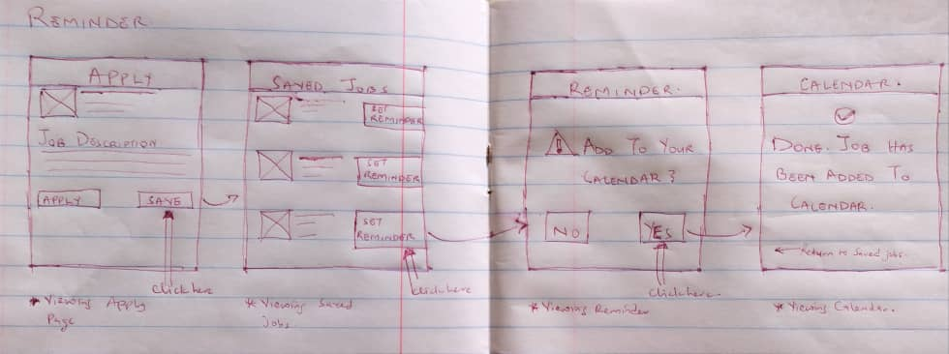
Solution Sketch 2 - Reminder

Slide 19
Decide
Pick the final concept that you develop into a prototype
Notes:
[ALL PARTICIPATION]

Slide 20
Decision
Decision | Reach Out (Referral)
Rationale | We want to use the underutilised space on people's profiles that signal what they do and jobs they are affiliated with. By specifying job preferences, candidates can gain value by leveraging their networks to view more opportunities. About 25% of candidates highlight that getting a referral is a hindrance to getting jobs they want. Also since most applications go into the application limbo, they have someone to reach out to when they’ve not received feedback for some time. In terms of effort to build, it should be relatively straightforward to build this functionality as we can leverage profiles that have the hiring card to build job boards on their profiles. However, we need to make sure this feature is fundamentally different from the Jobs feature that’s currently available.

Slide 21
Prototype
Turn your concept into a realistic, interactive prototype that you will use to validate your assumptions and ideas
Notes:
[ALL PARTICIPATION]

Slide 22

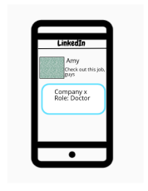
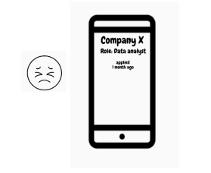
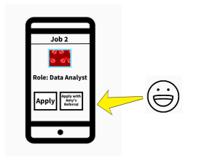
Storyboard
John checked again on his last job application. He hasn’t gotten any response from the company. He has been frustrated going through this process without any output. | Later that day, he checks his linkedin feed to see what's going on in his network. He saw Amy’s post requesting for people to check out her apply for positions at some companies. | After viewing the position, he decided to check Amy’s jobs board to check out for other jobs. | Entering Amy’s job’s board he immediately found a job that he felt he was a fit for. He was also surprised to see he could request a referral from Amy along with his applications.

Slide 23
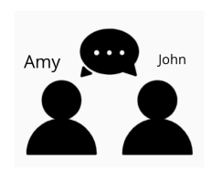
Storyboard
John excitedly clicked on the job and proceeded to ask Amy for a referral. | Amy agrees and gives John the referral he needs to apply to the job. John proceeds to apply. | Two weeks later, a recruiter reaches out to John to schedule an interview. After months of applying, John finally gets his first interview. He is more encouraged to apply for jobs knowing that his friends can help him with a foot through the door.
Aje company
Recruiter
Job Description
Apply with referral
Save

Slide 24

Prototype
Description High level overview of the prototype What does it do? | [Remove help text before you submit] Describe your prototype
Assumptions Any assumptions within the prototype | [Remove help text before you submit] List all assumptions you have made about the prototype
Tasks What are the tasks that a user can complete in the prototype? | [Remove help text before you submit] Describe the flows/tasks that a user can complete in the prototype
Link your prototype

Slide 25
Validate
Users will go through your prototype and provide feedback on your concept. This is also an opportunity to have an engineering feasibility discussion
Notes:
[ALL PARTICIPATION]

Slide 26
REFERRAL: Research Plan
PM: CHIKAMSO NWANI
STATUS: DRAFT
Objectives
To understand the job application process
To understand the effectiveness of referrals in job applications
Methodology
Since this is a new feature to an existing product, we should get 5 participants for the user research. I expect the interview to last for 30-45 minutes.
Participants
People who apply to jobs frequently
Their experience levels
People who have gotten jobs through referrals
People who connect others with jobs without being recruiters
Employed and unemployed people

Slide 27
REFERRAL: Interview Sessions
Introduction
My name is Kamso and I’m a Product Manager here at LinkedIn. The team’s been working on an exciting new idea about the job application process and we wanted to share them with you and get your feedback.
Background Questions
Tell me about yourself
How did you get your most recent job? What was the experience like?
How often do you apply for jobs?
Are there specific jobs you wouldn’t apply for using a jobs site?
What stops you from getting your ideal job?
Do you know any jobs that allow you use referrals to apply? If so, which ones?
What is your relationship with your current network on Linkedin?
Notes:
This interview will run for 30-45 mins. I have a few background questions to get to know you a little bit better and the way you find and apply for jobs. Then, we’ll switch gears and I’ll show you a prototype that the team has been working on and ask you for your feedback. Before we get started, do you have any questions I should know of?
No questions… Great! Is it ok if I record this session? The recording is only going to be used internally by the team to refer back to our conversation. It also helps make sure that we don’t miss anything in the notes.

Slide 28
REFERRAL: Interview Sessions
Tasks
[Disclaimers: Prototype-- not everything may work. You’re not being tested. Want your feedback on what we’ve built. Please think out loud]
Task 1
Go ahead and take a look around. Can you describe what you see
Task 2
How would you go about searching for jobs? Can you show me?
Let’s say that you wanted to apply for a Data science role. How would you do that?
Task 3
Let’s now say the job allowed you to apply with a referral, how different is this with the way you just applied for this job? Which do you prefer? Why?
Wrap Up
Awesome! Thanks so much for going through all of that with us. Just a few more questions
Do you think this is something you would use? Why or why not?
Is there anything you think could be improved?
Is there any other feedback you want to share with me?

Slide 29

User Testing: Participant 1 Key Findings
Link your audio recording
What worked well | Was able to apply to job
Where participants got stuck | Didn’t know how to search for jobs Didn’t understand what certain functions were meant to do e.g Save Was conflicted about the User experience about using the reach out/referral feature.
Other observations | Problems with user flows didn’t allow candidate understand the intention behind the feature

Slide 30
Participant 1: Interview Notes
Participant name: Obinna
Currently unemployed, not actively searching but can do something in the short term. Previous job was a mandatory due to country’s graduate laws.
Looking out for new positions in a new location and different language. Candidate is willing to do unconventional things to step out of comfort his comfort zone. Interesting stuff.
Previous jobs were gotten through referrals.
On Reach out/Referral feature. He didn’t consider it very unique as it could be a double edged sword. He would love to see metrics/testimonials on whether the new feature is actually working for others.
Since candidate has to reach out to network, he considers this to be a inhibiting factor.

Slide 31
User Testing: Participant 2 Key Findings
Link your audio recording
What worked well | Was successful in applying to job with referral
Where participants got stuck | Was conflicted about the User experience about using the reach out/referral feature.
Other observations | Problems with user flows didn’t allow candidate understand the intention behind the feature

Slide 32
Participant 2: Interview Notes
Participant name: Karen
Currently employed and transitioning into a product manager background
Past jobs were gotten through job sites and campus recruitment.
Looking to change company within the next 12 months.
She uses linkedin and Indeed very well in expressing interests at joining different companies and also creating alerts on job titles on them.
On Reach out/Referral feature. Candidate was unclear about the process. She felt the process should be less automated and more human. She considered that a better user experience would involve reaching out to the referrer and making sure that the people actually referred her.

Slide 33
Feasibility
 | Your Assumptions | Specific feasibility questions
Drawing the UI What data is needed to draw the UI on the screen? Where is the data coming from | Creating a jobs board for each profile should be easy. | Should we build this in-house or allow for people to populate links in this? What should we be thinking about with job boards?
User generated data Is it stored? Where/how? How wll that data be used again? | It wouldn’t cannibalise the current jobs feature we have active. Job data is coming outside of LinkedIn’s job repository. | Can we leverage the architecture behind the jobs feature to build job boards for each profile on LinkedIn? Since these are user generated jobs, what should we be thinking about in terms of privacy and how we use the data to make linkedin much more smarter?
Latency How quickly should things load? Are there any operations that might slow down load time (ie: a call to another service)? | None | None

Slide 34
Handoff
© 2019 Udacity. All rights reserved.
Notes:
[ALL PARTICIPATION]

Slide 35
Updated PRD
Background
In the past, college graduates would search and find jobs by going through volumes of fliers, posters, newspapers and other forms of media. This process was filled with a lot of faults; since there was no aggregated platform for jobs, candidates would waste time trying to filter jobs they were likely to get and in some cases not even finding the jobs they wanted. Also, since there was limited budgets to promote jobs, recruiters would not always present the whole picture about the jobs being offered and thus fail to reach relevant candidates. With the fast adoption of the internet and mobile phones, more companies are offering services to easily match candidates to jobs that they want
Problem
Job matching has always been a difficult process. Today more than 40% of applicants and candidates say that getting relevant and personalised jobs is more difficult to getting their ideal jobs. Many other businesses like Indeed are beginning to offer personalised services and it represents a huge threat to our business! Our competitors are starting to roll out services that provide a better experience in job application. In order to stay competitive, we need to leverage our existing network in connecting individuals directly to jobs they can succeed in. We really need to make it easy for users to find and apply to jobs thus minimising the stress in the process.
Goals
Build an app that allows users apply to jobs through referrals
Increase the number of successful applications through referrals in job boards.
Reduce the amount of time that users find relevant jobs.

Slide 36
Updated PRD (page 2)
Success Metrics
Increase user engagement in job boards by 50%
Increase successful applications through referrals by 20%
Reduce the amount of time users spend finding jobs by 20%
Increase following to job boards by 15%

Slide 37
Updated PRD (page 3)
key Features & Scope
Priority | Feature | Description
P0 | Post jobs with referral | The user can post jobs from their jobs board. This post is only visible to 1st level connections.
P1 | Job boards | The user can curate roles they support for people in their network to apply to.
P2 | Job boards ordering | Users should be able to filter the jobs boards just as they would filter any other feature on the platform. With this, users should be able to filter jobs by company, experience level and skills.
P0 | Apply with referral | The user should be able to see jobs that allow them apply with referrals. Also, this should allow them see a list of profiles they can request a referral for the specific job.
P2 | View more referral profiles | This is a premium feature that allows users see more than the maximum number of profiles. Users are only permitted to see a given number of profiles at a time but the paid product allows for them to see more.

Slide 38
Updated PRD (page 4)
Core UX Flow
Mocks
Prototype

